Slide 1
PHP continued…..

Slide 2
Arrays
Arrays have names that begin with $.
Its elements consists of key-value pairs.
Can have elements with positive integer
keys and/or string keys at the same time.
Elements of an array need not be of the
same type.

Slide 3
Arrays
2 ways to create an array:
Assign a value to an element of an array that does not exist
$my_array[2] = 2006;
Use the array construct
$my_array = array(); # creates empty array
or
$my_array = array("Hello",2,TRUE);

Slide 4
Arrays
$primes[0] = 2;
$primes[1] = 3;
$primes[ ] = 5; # 5 is stored in index 2.
Note: even if the script had a scalar variable called $primes before the assignment $primes[0]=2; $primes becomes an array.

Slide 5

Using keys as indices
Arrays may be indexed either by ordinary non-negative integers or by “keys”.
Example:
$ar = array("key1"=>"value 1", 67=>3, "a"=>10, 4=>"Hi");
We now have an array where instead of usual integer indices (0,1,...) We have keys indexing the slots.
By default ordinary indices are used:
$my_array = array(1,2,3,4); #keys 0,1,2,3

Slide 6
Accessing PHP Arrays
String key 'Joe'
$password['Joe']="Hello!";
$pw = $password['Joe'];
Number Key 2
$password[2]="Hello!";
Warning: "2" and 2 are the same key!

Slide 7
Printing array elements
You can interpolate array element variables, but
you have to be careful!
//These do not work!
print("Passwd:$password[‘Joe’].");
print "Passwd:$password["Joe"].";
//This is right.
print "Passwd:$password[Joe]";

Slide 8
PHP Array functions
• unset
Deletes the contents of a scalar variable, an array entry, or an entire array.
• count
Returns the number of elements in an array.
• sizeof
This is same as count.
• is_array
Returns TRUE if the argument is an array.

Slide 9
Example
$list = array(1,2,3,4); #keys 0,1,2,3
unset($list[2]);
Now $list has keys 0,1,3 and elements 1,2,4
unset($list);
Now $list is NULL
$a = 5;
unset($a);
Now $a is NULL

Slide 10
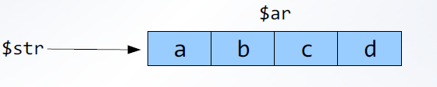
Explode
Explode is JS equivalent of split. It takes an argument of a string and a delimiter and returns an array consisting of substrings of the string.
Example:
$str = "a:b:c:d";
$ar = explode(":",$str);

Slide 11
implode
Implode does the inverse. It takes an array and returns a string where the entries are appended together using a delimiter.
Example:
$str = implode("^",$ar");
$str has the value: "a^b^c^d".

Slide 12
Accessing array elements in sequential order
Every array has an internal pointer which points to the "current" element of the array.
The "current" pointer is initialized to the first element of the array when the array is created
To access and dereference the "current“ pointer of an array, use the current function
$snacks = array("chips", “pizza", "candy");
$snack = current($snacks);
print("The first snack is $snack");
Output: The first snack is chips

Slide 13
Accessing array elements in sequential order
The next function moves an array's "current“ pointer to the next element in the array and then dereference it.
The prev function moves the "current" pointer to the previous element in the array and then dereference it.
$snacks = array("chips", "pizza", "candy");
$snack = next($snacks);
print("The 2nd snack is $snack");
$snack = prev($snacks);
print("The 1st snack is $snack");
Output:
The 2nd snack is pizza
The 1st snack is chips

Slide 14
More Array Traversing
reset function
•Moves an array's "current" pointer to the first element in the array and then dereferences it.
end function
•moves "current" to the last element in the array and then dereferences it.
$snacks = array("chips", "pretzels", "candy");
$first = reset($snacks);
print("The first snack is $first");
$last = end($snacks);
print("The last snack is $last");
Output
The first snack is chips
The last snack is candy

Slide 15
each function
Returns a two element array consisting of the key and the value of the "current“ element in the array.
The keys of the two element array are "key“ and "value".
It then moves the "current" pointer to the next element of the array or FALSE if there isn't one.

Slide 16
Example
$snacks = array("abe" => "chips", "abby" => "pizza",
"darin" => "candy");
while($order= each($snacks))
{
$partier = $order["key"];
$snack = $order["value"];
print("$partier wants $snack");
}
Output
abe wants chips
abby wants pizza
darin wants candy

Slide 17
Other array functions
•key($array)
– returns the key of the "current" element of the array
•in_array($value, $array, $strict)
– returns TRUE if the given $value exists in the array $array. If $strict is TRUE, then the type of $value must also match the type of the element in the array.

Slide 18
Sorting an array
sort($array)
• Sorts the values in $array, but replaces the keys by 0,1,2,3, etc...
• String values appear first in alphabetical order followed by the numeric values in ascending order.

Slide 19
Sorting an array
asort($array)
Same as sort($array), but key-value associations are preserved.
ksort($array)
Sorts $array by its keys, rather than by its values. Key-value associations are preserved.
rsort($array)
arsort($array)
krsort($array)
These functions behave the same as sort, asort,and ksort respectively, but sort in the reverse order.

Slide 20
PHP Form handling, session variables and regular expressions

Slide 21
How does a browser communicate with a program on a server?
By submitting an HTTP request to the server (possibly via an HTML form).
Such a request is made by a certain method. Each HTTP request method is different. There are several different possible requests, but we will concentrate on the two most frequently used ones
Get
Post

Slide 22
HTTP method GET
Browsers can pass parameters to a server script via a request URI.
Example:
http://www.nust.edu/~v/serverscript.php?x=1&y=2
The URL of the target PHP script is:
http://www.nust.edu/~v/serverscript.php
The query string is:
x=1&y=2

Slide 23
Query Strings
Appear after a question mark ? in a URL.
Consist of name=value pairs separated by ampersands (&).
name is the name attribute of a widget or control of the HTML form
Spaces in value can be replaced by + signs
Widget values in a query string can have special characters encoded as a % followed by a 2 digit hex ASCII code representing the special character.

Slide 24
GET vs. POST
GET method:
• Values (query string) are encoded directly into URI.
• Requests are cached by the browser, server, or proxy.
• Appropriate if the amount of data to send is small, and there are no side effects on the server.
POST method:
• Values encoded in a separate part of the HTTP request (query string is not visible in URL as it is in GET).
• Requests cannot be cached (each request is independent and matters).

Slide 25
Submitting an HTTP request using a form
• Click the submit button of the HTML form to send form data to the script or JavaScript function that will process the form.
• The action attribute is a URI or a JavaScript function call.
• The method attribute specifies the HTTP request method.
<form action="http://www.ucla.edu/some.php" method="post">
<!-- Form stuff -->
</form>

Slide 26
Processing Form Data
How does a PHP script get information from a client?
How does a PHP script get information from the server it is running on?
How does PHP save information from a session with a client?
Answer: Using PHP superglobal arrays

Slide 27
Superglobal Arrays
Superglobals are built-in variables that are always available in all scopes. There is no need to do global $variable; to access them within functions.
$_SERVER
stores data about the currently running server.
$_ENV
stores data about the current client's environment.
$_GET
stores data sent to the server using HTTP method GET.
$_POST
stores data sent to the server using HTTP method POST.
$_COOKIE
stores data contained in cookies on the client's computer.
$_SESSION
used by PHP to stores data pertaining to a the server's session with a client.

Slide 28
Form example using GET
<form action="../PHP/calculator.php" method="get">
<fieldset>
<label for="x">x: </label>
<input type="text" name="x" id="x" /><br/>
<label for="y">y:</label>
<input type="text" name="y" id="y" /><br/><br/>
<input type="submit" value="Calculate Sum" /><br/><br/>
<input type="reset" />
</fieldset>
</form>

Slide 29
PHP Script calculator.php
<?php
// Get the form data using form field names
// as keys for superglobalarray $_GET.
$x = $_GET['x'];
$y = $_GET['y'];
// Process form data
print("$x" . " + " . "$y = " . ($x + $y) . "<br />");
?>

Slide 30
Form example using POST
<form action="../PHP/calculator.php" method="get">
<fieldset>
<label for="x">x: </label>
<input type="text" name="x" id="x" /><br/>
<label for="y">y:</label>
<input type="text" name="y" id="y" /><br/><br/>
<input type="submit" value="Calculate Sum" /><br/><br/>
<input type="reset" />
</fieldset>
</form>

Slide 31
Processing post data
<?php
// Get the form data using form field names
// as keys for superglobalarray $_POST.
$x = $_POST['x'];
$y = $_POST['y'];
// Process form data
print("$x" . " + " . "$y = " . ($x + $y) . "<br />");
?>

Slide 32
Processing form data
Often when we process form data we have to check what data was actually submitted through the form.
Common method is illustrated in the following example:
$from = (isset($_POST["from"]))?$_POST["from"]:"";
Here we are checking if $_post array has value for the key called from. If it does we simply access the key and assign the value to a PHP variable that we call $from. If there is no such key/value we assign the default value of empty string ("") to the $from variable.
We use the common C++ syntax:(bool expression) ? do this : do that
Where do this is done if bool expression is true and do that is done if it is
false.

Slide 33
Session
Session is the time span during which a browser interacts with a particular server.
It begins when a browser connects to a server.
Ends when the connection is terminated or the browser connects to a different server.

Slide 34
PHP Session Tracking
You can create a unique session ID for your session by calling the function session_start().
Subsequent calls to session_start() retrieves the $_SESSION superglobal array.
$_SESSION array contains key-value pairs that were created by the script during the session.

Slide 35
Using session to authenticate
One of the common situations is that a person will have to log onto the website to gain access.
Once in the website, they are free to move among many pages. If the user has already logged in he should not have to re-login when he goes to the next page.
We can keep track of the user and whether the user has logged in or not through the session variable.

Slide 36
Example
<?php
// At this point user has already entered login information through a //form.
//This script has been called and users login and password have been //compared against a database.
//The password has been found to be correct and we will now grant the //user access.
//We now record that the user has logged in by storing his
//login at the session variable.
session_start();
$_SESSION['login'] = $login;
//Now we might direct the user to the main part of the website.
header("location: member-index.php");

Slide 37
Example continued
//We will know whether the user is logged in or not by the presence or //absence of login in the session variable.
//If a variable login exists in the session, then the user has been logged in and authenticated.
session_start();
if(!isset($_SESSION['login']) {
header("location: access-denied.php");
exit();
}
//If the login is set then the script will keep running and generate rest of the page.

Slide 38
Example continued
//To logout the user we can just unset his login in the session variable.
unset($_SESSION['login']);

Slide 39
Regular expressions
Regular expressions are used for searching patterns of characters through text.
For example you might want to extract all email addresses from a file.
Regular expressions pop up in many places, not just PHP so they are well worth it to learn.
Applications of regular expressions include data validation, data manipulation.
You can match phone numbers, email addresses, url's, credit card numbers, social security numbers, zip codes, states, cities.....(the list never ends).
A huge script that is supposed to validate a user input and prepare it for a database can be reduced to only one line with the help of preg_replace.

Slide 40
Patterns
Regular expressions are all about specifying a pattern.
You may have done a search on your computer for all doc files by searching for *.doc. Regular expression patterns give you way more flexibility, but the idea is the same.
Example:
[A-Z 0-9\._]+@[A-Z 0-9\.]+\.[A-Z]{2,4}
Matches an email address.

Slide 41
Building blocks of patterns
The simplest match is a single character:
Example:
Pattern: a
Input string: This is a fine day.
Match will be found in the word a as well as in word day.
Single character is any character except: [\^$.|?*+()
These are special characters that we will talk about shortly.
Any special character can be written as a regular match character if you escape it with a \

Slide 42
Simple patterns
Pattern: apple
Result: Matches any occurrence of apple. Including Snapple.
Pattern: ^apple
Result: Matches only words that begin with apple.
Pattern: apple$
Result: Matches only words that end with apple.

Slide 43
Character classes
Examples:
Pattern: [JTV]
Result: Matches a single character which is either J or T or V.
Pattern: [a-z]
Result: Matches any character a through z.
Pattern: [^nust]
Result: Match any character that is not n,u,s,t.

Slide 44
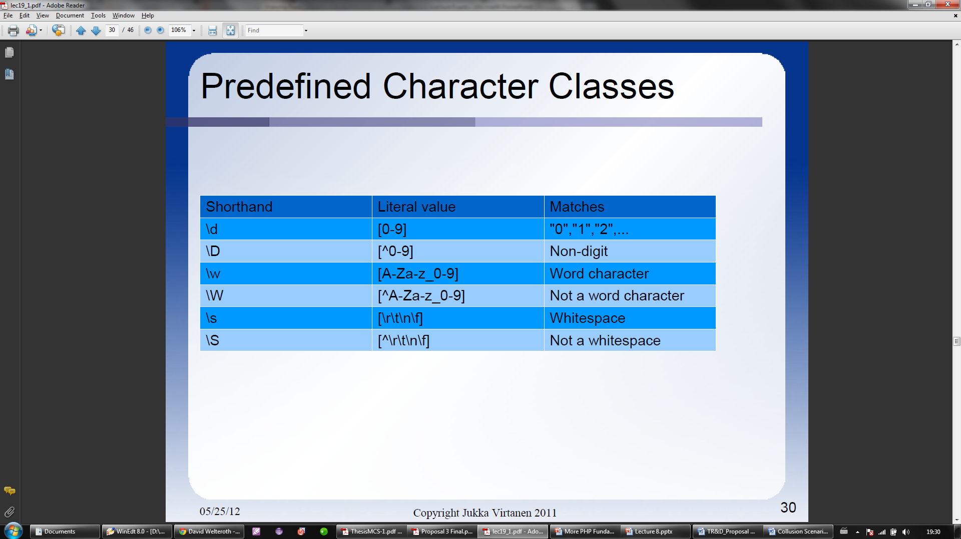
Predefined Character Classes

Slide 45
Count indicators
Pattern: [1-5]*
Match: A number 1-5 may occur 0 or more times.
Pattern: [H-S]+
Match: A letter H-S must occur at least once.
Pattern: [v]?
Match: The letter v may occur once or not at all.
Pattern: [nust]{2,3}
Match: Any of n,u,s,t may occur twice or three times.

Slide 46
More regular expression examples
A zip code:
[0-9]{5}
NUST email:
[a-z][a-z0-9]{2,14}@nust\.edu\.pk
Telephone number in (XXX)-XXX-XXXX form:
\(\d\d\d\)-\d\d\d-\d\d\d\d

Slide 47
More regular expression examples
“ab*” : matches a string that has an a followed by zero or more b's ("a", "ab", abbb", etc.);
“ab+” : same, but there's at least one b ("ab", "abbb", etc.);
“ab?” : there might be a b or not;
“a?b+$” : a possible a followed by one or more b's ending a string.
You can also use bounds, which come inside braces and indicate ranges in the number of occurences:
“ab{2}” : matches a string that has an a followed by exactly two b's ("abb");
“ab{2,}” : there are at least two b's ("abb", "abbbb", etc.);
“ab{3,5}” : from three to five b's ("abbb", "abbbb", or "abbbbb").
Note
You must always specify the first number of a range (i.e, "{0,2}", not "{,2}").
The symbols '*', '+', and '?' have the same effect as using the bounds "{0,}", "{1,}“, and "{0,1}“, respectively.

Slide 48
More regular expression examples
"a(bc)*" : matches a string that has an a followed by zero or more copies of the sequence "bc";
"a(bc){1,5}" : one through five copies of "bc."
There's also the '|' symbol, which works as an OR operator:
"hi|hello" : matches a string that has either "hi" or "hello" in it;
"(b|cd)ef" : a string that has either "bef" or "cdef";
"(a|b)*c" : a string that has a sequence of alternating a's and b's ending in a c;

Slide 49
More regular expression examples
A period ('.') stands for any single character:
"a.[0-9]" : matches a string that has an a followed by one character and a digit;
"^.{3}$" : a string with exactly 3 characters.
"[ab]" : matches a string that has either an a or a b (that's the same as "a|b");
"[a-d]" : a string that has lowercase letters 'a' through 'd' (that's equal to "a|b|c|d“ and even "[abcd]");
"^[a-zA-Z]" : a string that starts with a letter;
"[0-9]%" : a string that has a single digit before a percent sign;
",[a-zA-Z0-9]$" : a string that ends in a comma followed by an alphanumeric character.
You can also list which characters you DON'T want -- just use a '^' as the first symbol in a bracket expression (i.e., "%[^a-zA-Z]%" matches a string with a character that is not a letter between two percent signs).

Slide 50
preg_match
preg_match($pattern, $string ) is a built-in function for matching a regular expression in PHP
$string : Any string i.e url, email, names, telephone numbers
$pattern : the matching expression required to be found in $string
Returns 1 if it finds a $pattern match in string, 0 otherwise.
Stops looking in $string after the first match of $pattern.
Returns FALSE if an error occurred.
We have to add slashes around the expression for pattern.
$pattern = “/nust/";
Example:
<?php if (preg_match("/php/", "php")) { print "Got match!\n"; } if (preg_match("/php/", "PHP")) { print "Got match!\n"; } ?>

